Slide 1



Somerset DofE Award
&
Somerset Freemasons
A Partnership in the Community

Slide 2






What is the DofE
Notes:
345900 started last year and 177000 achieved - over 500000 active – UK
Worlds leading youth award –national and UK
Recognised by businesses - soft skill qualification

Slide 3
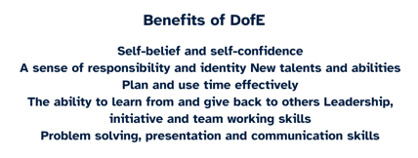
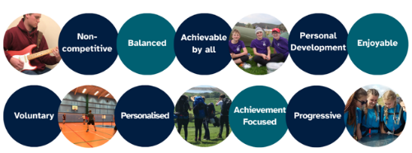
Benefits &
Principles of the DofE
Award
Notes:
Their award – not academic – chosen by YP

Slide 4
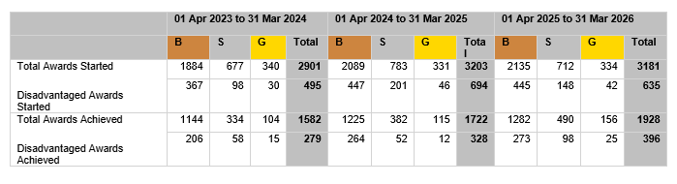
DofE in Somerset
Currently 73 delivering centres across the county, and Open Award Centre
Over 30 specialist providers
Working at 20% disadvantaged sign ups – over double the national average
Approx 40% of year 9 start and 46% of those achieve an award
Notes:
30.9% of 14-year-olds in the UK started their Bronze DofE in 2025/26 – UK stats – Somerset are higher

Slide 5
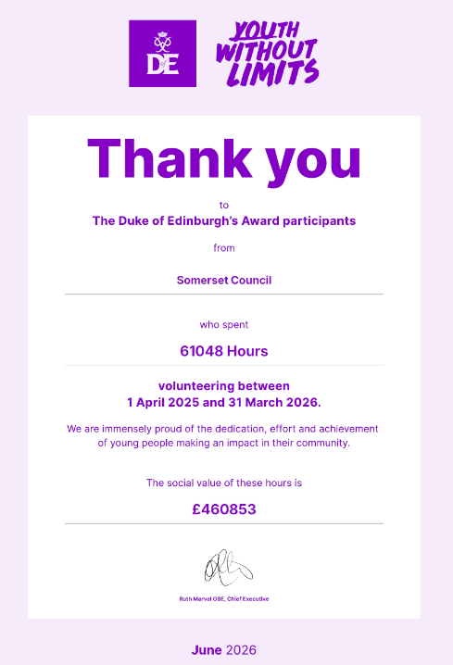
Volunteering
and
Social Hours
Notes:
Giving back to community – charities, making a diffference

Slide 6
Somerset Stats - Our Funding Issue
# YP at risk of NEET
We currently have high percentages of CYP who are not known, and investigations are ongoing regarding risk of NEET.
#YP with SEN / disadvantaged
Number of children and Young People with EHCPs – 6906 (Education, Health and Care plan)
Number of children and Young People with SEND Support – 11022
% PP / FSM
Pupil Premium CYP as percentage of those on roll - 23.7%
Free School Meals as percentage of those on roll - 21.3%
These figures are based on DfE figures from Jan 26.
Number of Home educated
2065 across the county - approx. 2.9%
Notes:
110,000 to 120,000 children and young people under the age of 18/20 - Aged 10 to 19: Around 62,451 children and young people

Slide 7


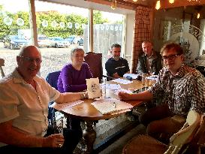
2016 – The Start of the Partnership
A long-standing relationship as part of the Somerset DofE Bursary Committee, which consists of a group of like-minded people that work with the award and young people across the county – promoting the award within various organisations like Air Cadets, Scouts, Sea Cadets, Combined Cadet Force, Local Business, Lord Lieutenant Office, Somerset Council, Rotary Club, Freemasons, DofE, Local Schools and more. The committee was established in 2016 and is still going strong.
Notes:
Raising funds for disadvantaged young people across the county to ensure that money is never a barrier to starting an award.
As a Committee they are also responsible for reviewing each participants application and deciding whether funds can be released.
Committee process – outline

Slide 8
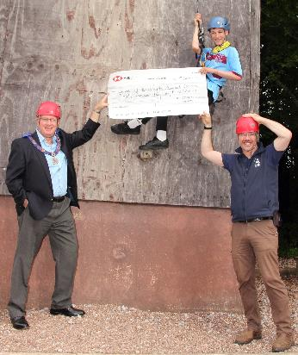
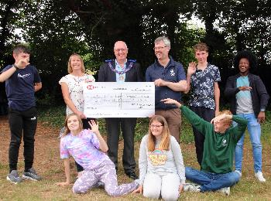
Making A Difference
£30000 raised by the Somerset Freemasons following on from the sad passing of their patron HRH Prince Phillip. £10000 of which was ring fenced for an alternative DofE Programme and the rest for the bursary fund.
Notes:
A lovely presentation and morning spent with bursary participants and one of the SEN schools that had benefited from funding also
Shock – expecting £10K and given £30K!!!

Slide 9
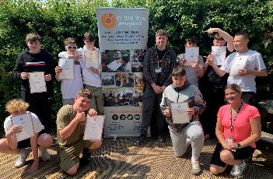
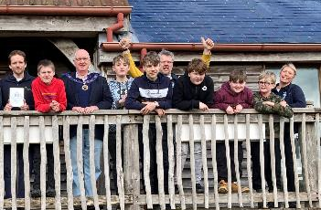
Alternative Programmes
Using the DofE Award as a framework, to help young people who are NEET / Risk of NEET (not in employment , education or training)
To date 144 YP given this opportunity
Notes:
Freemason funding has allowed up to run programmes like this for the past six years – we rely on funding for these programmes and would love to be able to offer more.
Working with youth workers and gaining and award, gives these young people the chance to learn life skills, give back the community, become fitter and learn to communicate better, alongside resilience, commitment and teamwork.
Small group working, youth mentor, 1-2 programmes a year , funding issue. But crucial to turn lives around.
Providers set up – ITM, Carymoor, MF – have YP + providers – just no funding!

Slide 10
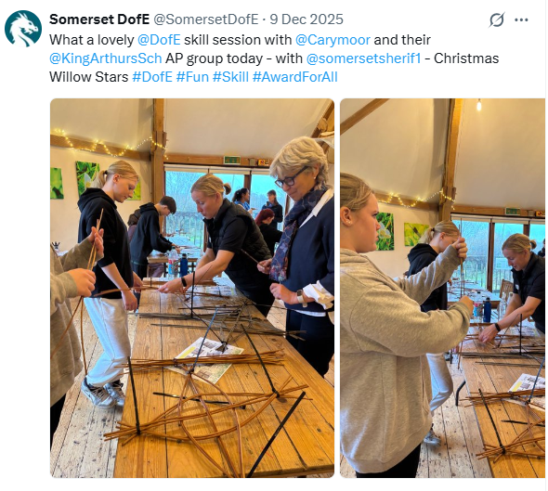
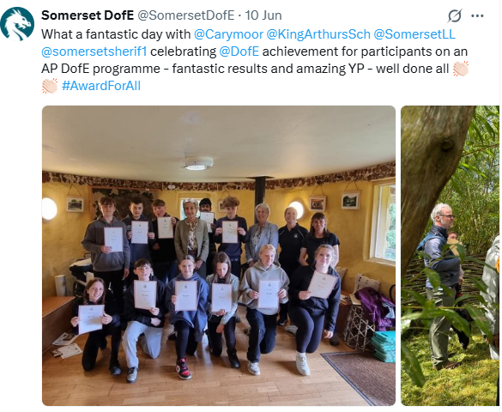
Notes:
Spread the word, Lieutenancy, HS - share success, social media – even used at HS fundraiser dinner!

Slide 11
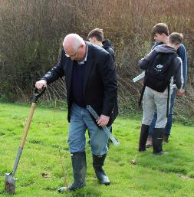
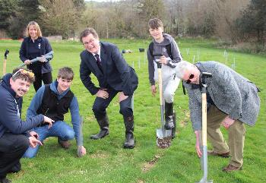
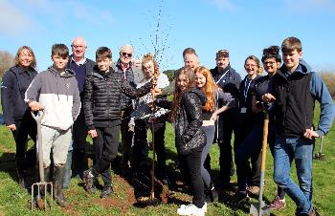
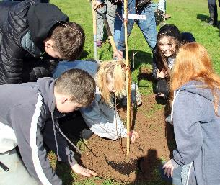
Tree Planting
So Many Trees…….
Notes:
So, another event and naturally our friends from the Freemasons attended also – to help us plant – suit and wellies David !
We have done many tree planting events over the years with various supporters, and bursary awardees
Somerset DofE was awarded a Jubilee Tree due to the work that we did with the Lord Lieutenant in 2022, on a series of Jubilee Jaunts across the county.

Slide 12


The Forming of an Idea
A Community Partnership – to help raise funds and make a difference

Slide 13
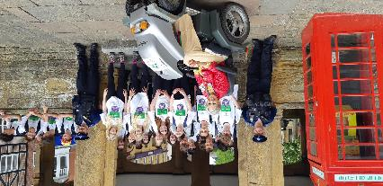
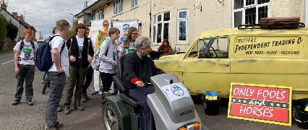
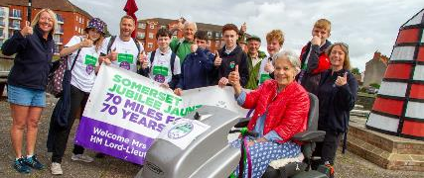
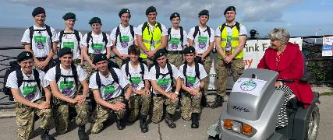
Somerset Jubilee Jaunts
In 2022, Somerset DofE was involved with the then Lord Lieutenant Annie Maw, on a series of Jubilee Jaunts, exploring the countryside of Somerset with DofE Centres around the county. Annie is wheelchair bound, so we did 7 Jaunts of 10 miles each – to reflect and celebrate the late Queens Platinum Jubilee
This was a huge success and gave us the basis for the Freemasons and DofE Bike Rides and Walks

Slide 14
Bike Rides and Walks
What do you do when a like-minded soul approaches you with an idea – you explore, grow and nurture it.
Over the past few years, we have held 5 different events – with the Somerset DofE Team, Somerset Freemasons and local schools – giving young people the chance to learn about the Freemasons and visit some lodges
Notes:
Ben, Stephen, took and idea and ran with it

Slide 15
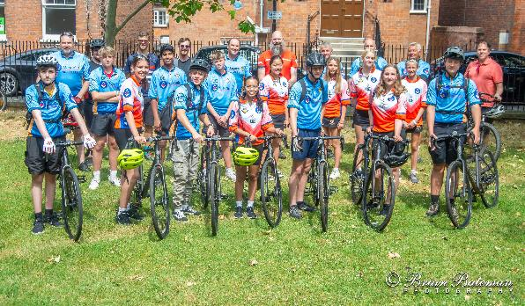
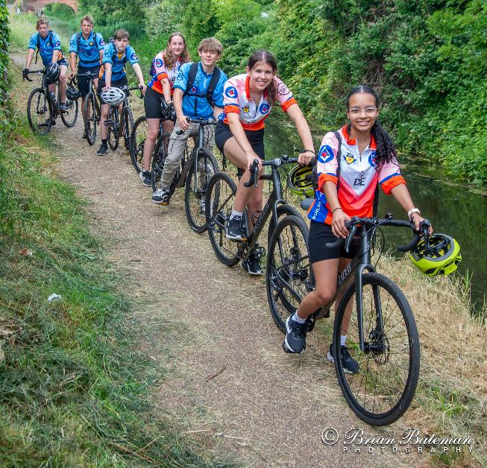
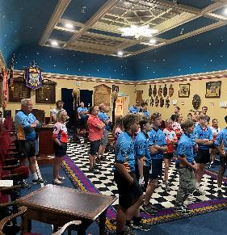
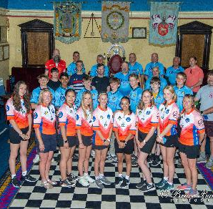
Taunton to Bridgwater and Back – King’s College and Haygrove School

Slide 16
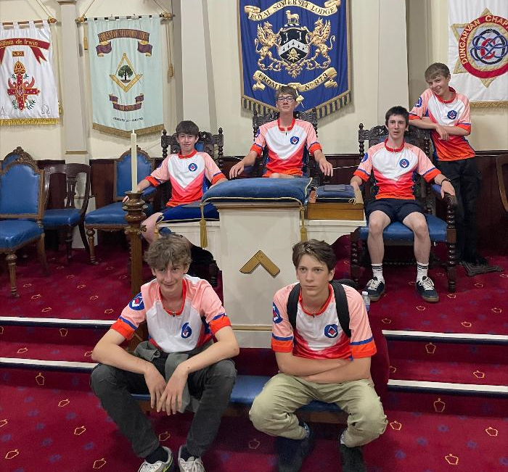
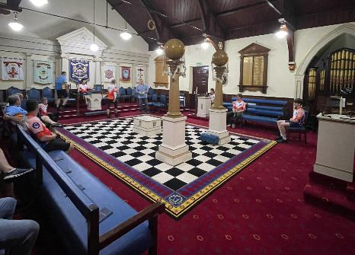
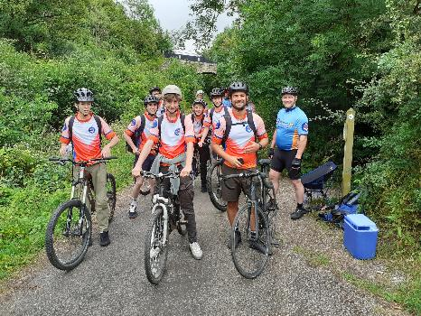
Frome Community College

Slide 17
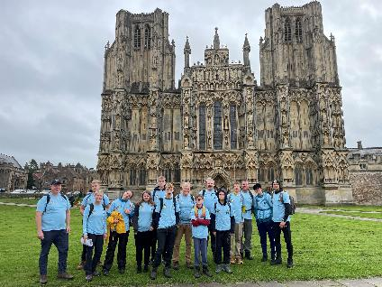
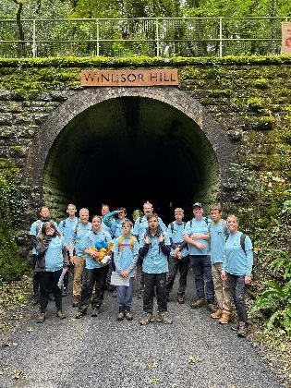
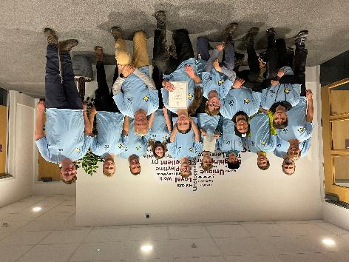
The Mendip School

Slide 18
Sam – A Partnership with Yatton & Wedmore Lodges
Freemasons from Yatton and Wedmore Lodges came together to help support a young man with his silver DofE award. In June, a walk was held with Freemasons, Kings of Wessex staff and students and Somerset DofE, to once again celebrate this partnership of like minds. The weather didn’t quite hold but everyone enjoyed the walk down the Strawberry line and look around the lodge at Yatton.
Sam is now on his Gold Award, and looking forward to completing it and heading to the palace
Notes:
Sam is a remarkable young person who has limited mobility but that doesn’t stop him from aiming high and being an active member of the Cheddar community and popular student at Kings Academy. Sam managed to complete his bronze DofE expedition in a wheelchair, but for his Silver he wanted to canoe with his peers, which meant that adult supervision throughout the training, practice and qualifier where needed, on a 1-2-1 basis to help support Sam and keep him safe. Somerset Freemasons stepped in to help pay for this adult member of staff with canoe and first aid qualifications, to enable Sam to complete this key section of his award.
Sam’s Dad also came along as a thank you, as Sam was involved in a church event on the same day, but he had previously been to the lodge to meet Stephen and others.

Slide 19
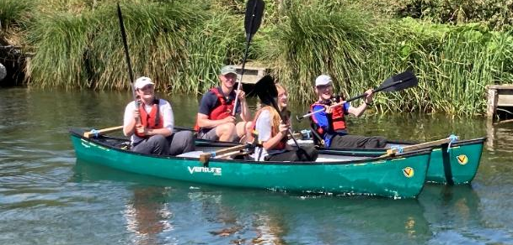
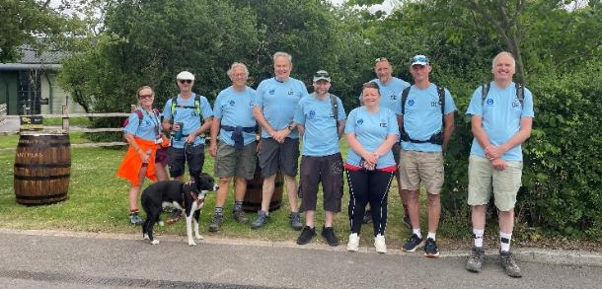
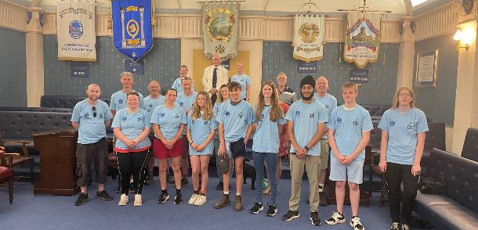
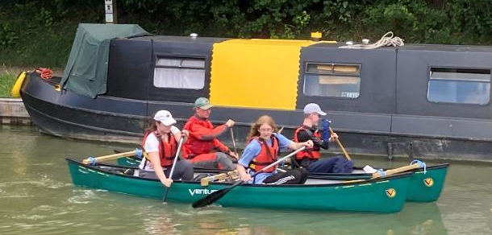

Slide 20
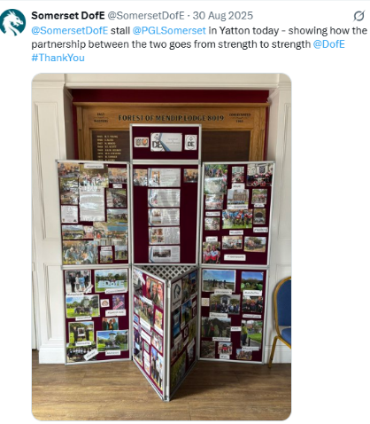
Summer Event support

Slide 21
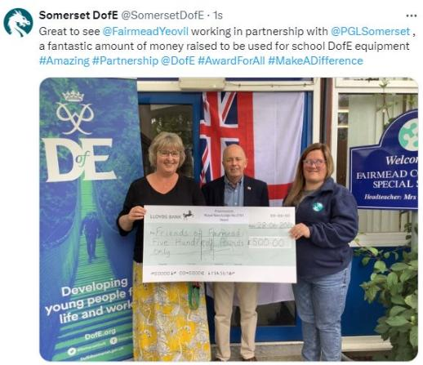
Fairmead and Yeovil Lodge

Slide 22
Prejudice
Through the bike rides we have been able to breakdown misconceived prejudice and barriers against the Freemasons. One parent questioned their school about the collaboration
Somerset DofE responded to this directly, mentioning the £50 million that the Freemasons raise annually for charity. The fact that there are Men and Women Freemasons, we also bought up misunderstanding and prejudice, as well as history – all of which has created barriers and preconceived ideas towards the Freemasons.
We offered parents the chance to visit the lodges also to see and understand what goes on – as well as mentioning the principles of the Freemasons – Charity, Respect, Integrity and Friendship
Notes:
I have received a call from Mrs X whose child has been invited to go on the D of E bike ride (in association with the Freemasons). Mrs X wants to know the extent of collaboration with the Freemasons and is concerned as a letter had the Freemasons logo on it.
Mrs X expresses concern that Freemasons don't accept women and the prejudices that the order is believed to hold.
Mrs X’s young person, attended the bike ride – so barriers were broken down, the message was shared about the great work that the Freemasons do within local communities, and the event was a great success.
We didn’t shy away from the challenge - but used it to help educate everyone involved

Slide 23
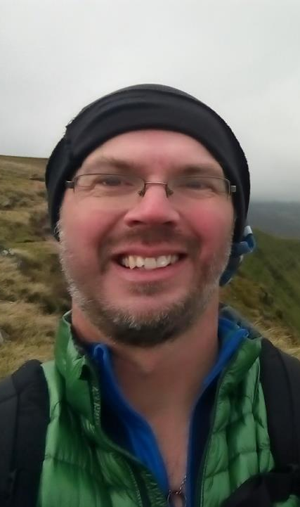
Facts and Figures
A Report from David Hamlin
Bursary Application Manager

Slide 24
In 2016 – we started the bursary committee with likeminded individuals from across the county
By 2019 we had £27000 in the account from various donations and pots of funding from Open Award Centres and Childrens Services
Since 2021 the Somerset Freemasons have donated £38000 and the Masonic Community Foundation a further £7500
Funding

Slide 25
Support
Since 2016 we have supported 921 participants on their award journey
In 2019 we had just 15 ‘Specialist’ Centres (SEND / AP) and 184 awards were achieved in this area
In 2026 we had 31 ‘specialist’ Centres, and 396 awards were achieved in this area
This growth is in part due to the amazing Somerset Bursary and being able to support ALL young people that need it

Slide 26
DofE Resilience Funding
The Masonic Community Foundation donates to DofE directly also. Whilst we are unsure of amounts, we have benefitted hugely from the DofE Resilience fund in Somerset over the past few years
2023 = £4420
2024 = £28603
2025 = £26777
2026 = £4679
This has been funding for Adult Training, Expedition Equipment, Sectional Equipment, Participation Places and Expedition Support

Slide 27
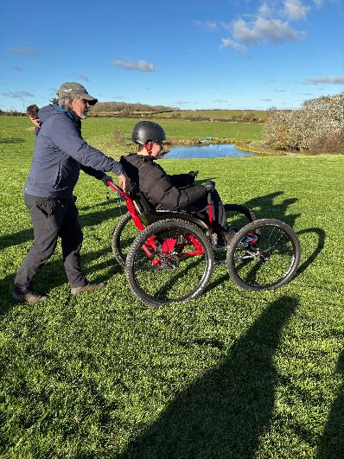
ParaTrekker
The bursary committee donated £1000 towards a Paratrekker, along with funding from DofE, Rotary, Somerset CF - we were able to buy this – to support any participant in Somerset on their expedition

Slide 28
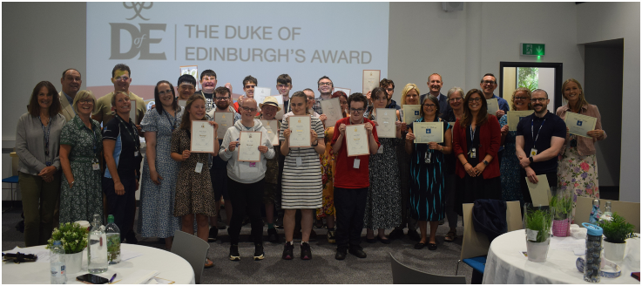
Thank You
I just wanted to write to you again to say a huge thank you to your team for supporting us through our first expedition. Your help with securing funding was invaluable as this has meant that we have been able to give our students the full experience and purchase some equipment that we can use in future expeditions.
So, thank you again, can’t wait to get stuck into next year and the adventures to begin!
Ellen and Ali
Notes:
BTC Foundation Group – Presentation Day for their Bronze and Silver Achievers, the bursary fund helped them get this programme off the ground and embed within the curriculum at the college for these young people – attended by Richard Winter too, so he could understand the difference the funding makes to all involved.

Slide 29
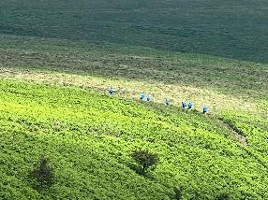
Thank You
I finished my Silver DofE expedition yesterday and wanted to give you some feedback on how it all went as promised.
For my volunteering section I worked in my school's library helping younger children with some reading and organising. This sparked an interest in me of helping children and has led me to becoming very interested in pursuing educational psychology as a career. I am so glad that doing Silver DofE inspired me to volunteer in the library and gain experience working with children.
For my physical section I joined a local Pilates class. This massively boosted my confidence in being comfortable in working out surrounded by others. I was also the only young person there with all other people being around 50 years or older. Even though it was intimidating to begin with, I thoroughly enjoyed engaging in this physical activity and getting confident talking and surrounding myself with people of all ages.
For my skills section I decided to do cooking. This has really helped grow my independence in being self-sufficient and has made looking at living alone for University seem far less intimidating as I know I can now cook well while using a variety of meats and vegetables. I have also become far more aware of making meals that are nutritious and good for my health.
During the expedition, I really challenged myself to take on more map reading. This was a skill I did not do much of in the Bronze DofE, so I am so glad I was able to do Silver and make myself more confident around maps. Doing the expedition has really helped with my personal development of team leadership skills and dealing with difficult situations. In the expedition, one of the members of my group had a panic attack and was struggling to breathe at one stage. This was a scary experience, but also showed me that I can take on situations when I need to and that I am capable of more than I may believe I am. I also carried the tent for 2/3 days that we were walking. This was something that I could never have done at Bronze, and it was really satisfying to see how my time at the gym and engaging in Pilates had helped me to gain the strength I needed in order to do this. I have gained confidence through doing the Silver expedition and it has massively helped me to develop my personal growth in leadership skills and facing adverse situations.
I was unsure before about taking on Gold, but now that Silver is over, I am really keen to hopefully get the chance to do Gold canoeing.
Thank you so much for giving the bursary and enabling me to do Silver. It has been a massive part of my development as a person and has been an experience I will never forget.
RP – Silver Open Award Participant
Notes:
An example of a thank you letter received from a partipant - who had bursary funding – clearly showing the difference an award can make to a young person - Picture is Rebekah and her team on Exmoor with SSE Outdoors, the AAP who ran the exped.

Slide 30
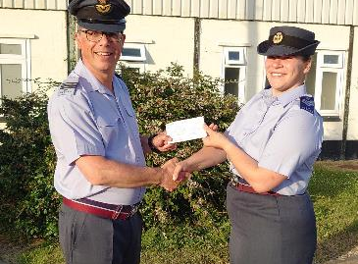
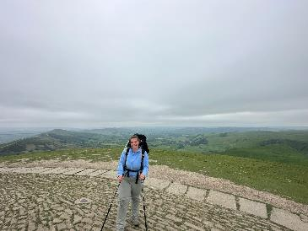
Thank You
From 27th May to 2nd June, I undertook my Gold DofE Expedition in the Peak District. As part of the Covid accommodations, this was a 'Back-to-Back' expedition, meaning it included a two-day practice followed immediately by the four-day qualifying expedition. To say that it was a tough week is an understatement, but my team and I bonded incredibly well considering that we didn't know each other until the first day, and that bond is what got us through the 6 days.
We were very lucky with the weather too; every day was sunny but not too hot, except for the one day up on Kinder Scout which was incredibly foggy and windy! We were treated to some stunning views, and it was overall a brilliant experience that I feel very proud to have achieved.
Completing the expedition now means that I have completed the Gold Award, and I am now awaiting my invitation to receive my certificate in person.
I wouldn't have been able to do all of this without the support of so many people around me, including the generosity of the DofE Somerset Committee and I am so grateful for that.
I look forward to supporting young people to achieve their awards at helping the DofE officer throughout Devon & Somerset Wing.
Daisy

Slide 31
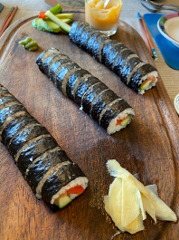
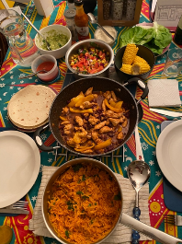
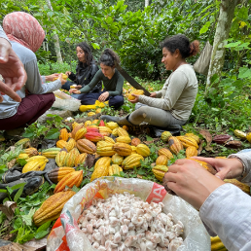
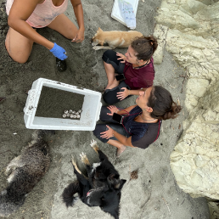
Thank You
I initially started Bronze DofE with some friends more for the social aspect but continued eagerly throughout the rest of the levels for all the aspects of the award. I gained new skills such as map and compass reading. In an age of technology and Google Maps, I felt more independent and safe knowing that I now had the skill to navigate without such devices. Another and very key skill I improved was team skills. Facing the physical challenge of the expeditions together I learnt the importance of listening and being compassionate in a team setting. Finally, committing to all the other sections of the award made me more responsible and prepared me for the next stages of my life. Such as improving my cooking skills in preparation for independent living during university. I participated in all three levels of the award and for me, this was not just an award but an experience. One that gave me skills for life, new friends, and fond memories, like wild camping in the valleys of Exmoor surrounded by wild horses or saving turtle nests on beaches in Ecuador. Therefore, I am extremely grateful I was given the opportunity to participate due to the bursary scheme. BF Bursary Recipient
Skill – cooking from around the world
Residential in Ecuador, relocating turtle nests to the nursery and harvesting cacao

Slide 32
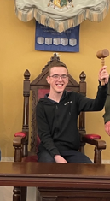
Thank you
My name is Sam, and I have recently completed my Silver DofE award.
For the expedition, we trained to kayak on the Kennet and Avon Canal and then went from Hereford to Symonds Yat on the river Wye for the assessment. It was very much fun and provided me with a lot of confidence, being outdoors with this incredible challenge.
I would especially like to thank Esther Bryans, Somerset DofE and the Somerset Freemasons for making it possible.
Sam, Kings Academy pupil

Slide 33
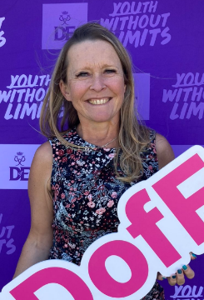
Thank You
It has been a pleasure to be able to support Sam on his journey through the Bronze and Silver Duke of Edinburgh award. Sam undertook his Bronze on the Quantocks with an adapted expedition and when he said he wanted to do his Silver expedition as a school, we said we would try to help him do this with his school peers.
In order that the entire team were safe on the water it was determined that a qualified instructor would be paddling in the raft with Sam and his team. This additional huge cost was paid entirely by the Yatton and Wedmore Freemasons. Without this funding Sam would not have been able to undertake this kind of expedition with his peer group and would have had to go alone to a specialist provider.
Kings Academy are very grateful for the opportunity that the Freemasons have been able to afford Sam in completing his Silver expedition in the manner in which he was going to get the most out of it. Please note that Sam has completed his entire Silver award and is already talking on the challenge of the Gold award. Kings Academy are very proud of him and his peer's achievements.
Esther – Kings Academy DofE Leader

Slide 34
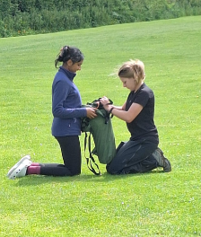
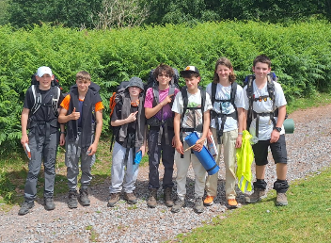
Thank You
We are incredibly grateful to Somerset Freemasonry for the bursary funding awarded to our children, Luke and Meghan, towards their Duke of Edinburgh Bronze and Silver awards. We were very pleasantly surprised to hear that they had both been selected for support, having not realised that funding such as this was available. We are particularly thankful to Esther, the DofE Coordinator at Kings of Wessex Academy, for putting them forward. As a family, the additional cost of extra-curricular activities can be a concern, so the bursary meant that Luke and Meghan could take part alongside their friends without worrying that they were adding to the financial pressure at home. That made a real difference to them.
The DofE experience itself has given them so much more than simply completing an award. Through their volunteering, Luke helped younger pupils with their SATs maths, learning the importance of being punctual, reliable, calm and patient, as well as gaining an insight into what it is like to be on the other side of the classroom. Meghan volunteered at our local church coffee morning, where she has enjoyed meeting and helping older members of the community. It has been lovely to see her become more confident socially and recognise the difference that young people can make to people who may otherwise feel isolated.
For their skills, Meghan chose to learn German, building on the years we spent living in Germany when she was younger, while Luke completed a Rookie Lifeguard course, developing valuable swimming and first aid skills which could potentially lead to future employment.
Their expeditions have also been a fantastic experience. Spending time outdoors, navigating, preparing meals, carrying all their own equipment and coping when things do not go to plan have taught them resilience, responsibility and teamwork. They have learned to look out for each other, encourage one another when someone is struggling and understand that the whole team had to work together to reach the end.
We are very thankful to Somerset Freemasonry for helping make these opportunities possible. The bursary has not only helped with the practical cost of taking part but has allowed both children to experience new things, develop confidence and independence and create memories with their friends that they will carry with them for many years.
Mum of Luke and Meghan

Slide 35
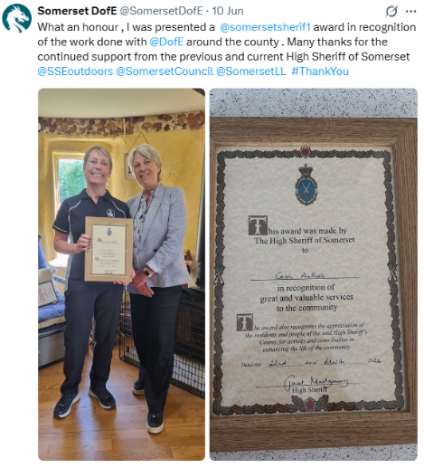
High Sheriff Award
Whilst I may have received this award, it is really an award for Somerset.
The incredible funding we have had, allowing so many YP to access the award. Making a huge difference across the county

Slide 36
What Next…..
Aim
Aim for more Alternative Provision Programmes, we have three fantastic providers but need funding
Continue
Continue to support ALL disadvantaged Young People around the Somerset County to access the award
Grow
Grow our offer to include more SEND / AP / CIC groups - search for new ones to join our ever-expanding network
Reach
Reach more home educated Young People , through our Open Award offer

Slide 37


Thank You
The DofE award in Somerset goes from Strength to Strength, we have an amazing network and a huge amount of support. Our SEND centres alongside Alternative Provision Programmes mean that DofE is truly Award for All Young People in our county
Friendships have formed with the Freemasons, and we have also opened doors to the local lodges, enabling young people to access them and see the great work that goes on within them, breaking down barriers and prejudice along the way.
DofE and the Freemasons share so many values, that this is an easy partnership to have. The support given over the past 10 years has been amazing, We owe so much to everyone that has helped us grow the award offering support to so many young people across the length and breadth of the county
I look forward to seeing what the future brings and future events, more laughs and days out
Notes:
that alongside DofE resilience funding, as well as other charities like Prowdes Education Foundation, Soroptimist International, BFEF, Rotary and Somerset Community Foundation.

